Slide 1
Unlocking the Packet Tracer Grading Rubric
Note: For Packet Tracer ver 7.3

Slide 2
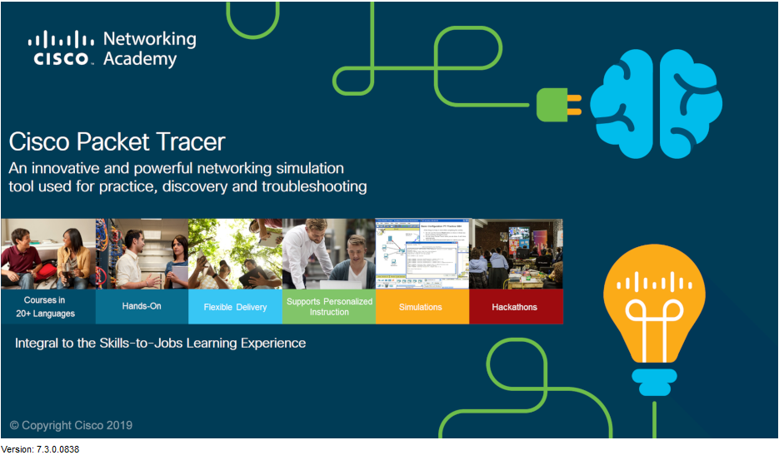
Unlocking the Packet Tracer Grading Rubric Packet Tracer version 7.3
The examples used in this presentation are for Packet Tracer version 7.3.
The concepts are the same for other versions, however the screens may appear different.

Slide 3
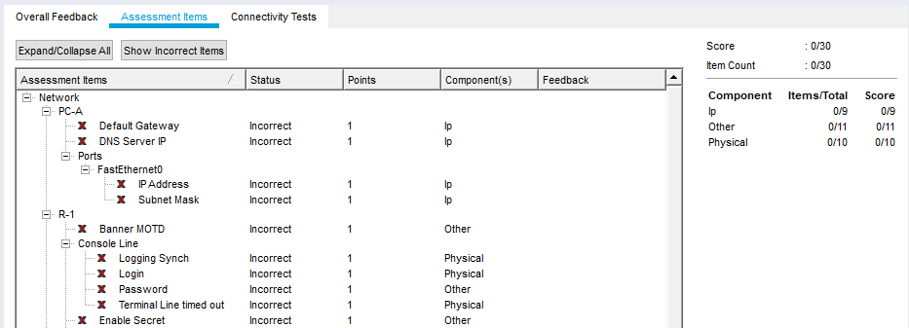
Unlocking the Packet Tracer Grading Rubric Assessment Items
Note that the ‘Assessment Items’ (if available) only display the category for the correct or incorrect items, not the detail about the expected values.

Slide 4
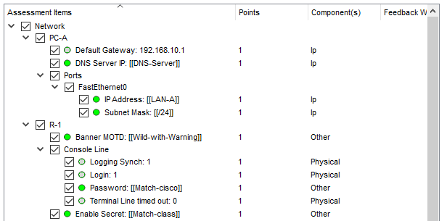
Unlocking the Packet Tracer Grading Rubric Assessment Items (cont)
Accessing the integrated grading rubric (going beyond ‘Assessment Items’) allows you to verify what values the Activity considers ‘correct’. Sometimes these are displayed directly in the rubric and other times they are a variable and must be accessed elsewhere - more to come.

Slide 5
Unlocking the Packet Tracer Grading Rubric Assessment Items (cont)
Packet Tracer Activities (with .PKA file extensions) have two versions of the assignment – The ‘Answer Network’ and the ‘Initial Network’.
The Answer Network is the completed activity with all the expected values configured.
The Initial Network is what the student sees when they are working within the Activity. It is generally a copy of the Answer Network with some or all the cabling and configurations missing. Some items may also be locked or hidden.
Certain items (including connectivity) are selected by the lab author to be compared between the values the student enters in the Initial Network and those in the Answer Network – this is the basis for the Grading Rubric.

Slide 6
Unlocking the Packet Tracer Grading Rubric Save Your Existing File!
Important: Before accessing the Activity Wizard, Save the Packet Tracer Activity somewhere you can find it again!
Note: When you access the Activity Wizard it will erase all the configurations if you save the file again. You want to have the original activity backed up safely.
If the original Packet Tracer file was downloaded from the curriculum, it may be in a temporary file location that will be difficult to locate. Use ‘File >> Save As’ to an accessible location like the Desktop.

Slide 7
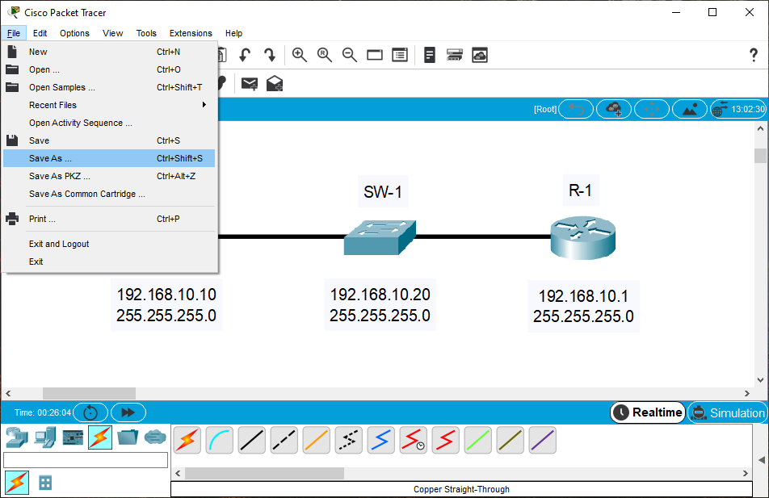
Unlocking the Packet Tracer Grading Rubric Save Your Existing File! (cont)
Using the ‘Save As’ feature:
1
2

Slide 8
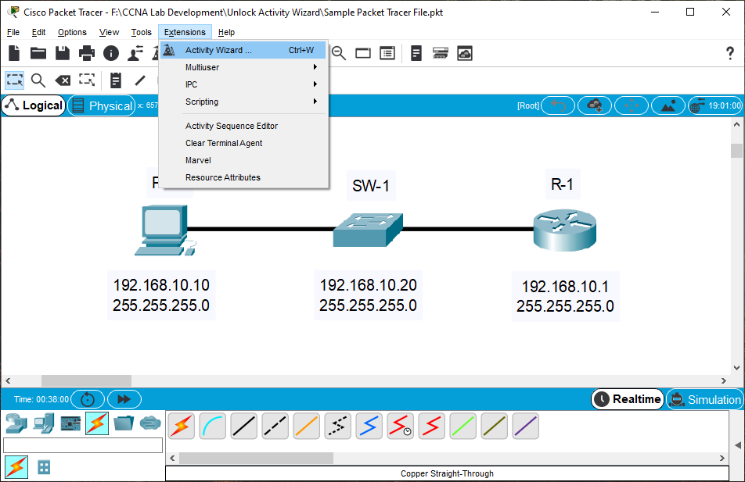
Unlocking the Packet Tracer Grading Rubric Save Your Existing File! (cont)
In the top menu bar of the Packet Tracer screen is the ‘Extensions’ tab. Within the dropdown for the Extensions tab is a selection for ‘Activity Wizard’. You may also use the keyboard combination ‘Ctrl-W’ to open the Activity Wizard screen.
1
2

Slide 9
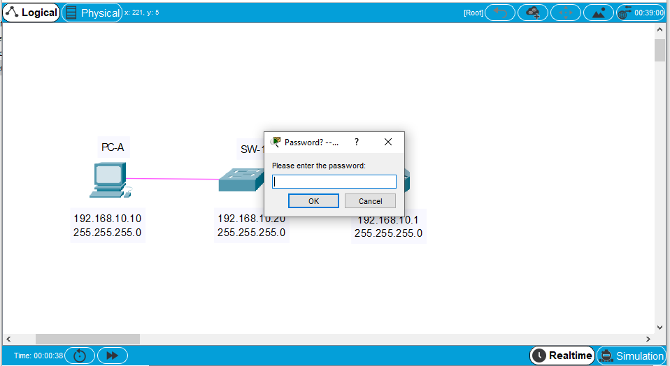
Unlocking the Packet Tracer Grading Rubric Unlocking the Activity Wizard
If the Activity is locked, passwords for Network Academy labs are available within NetAcad Resources >> Packet Tracer resources >> Packet Tracer Community >> search for ‘passwords’.

Slide 10
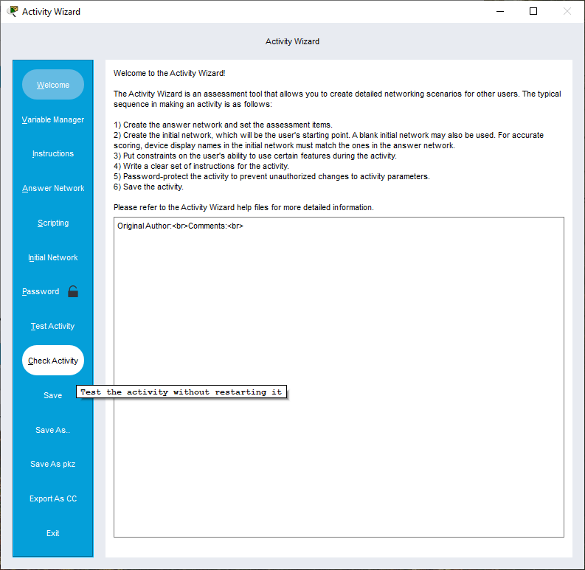
Unlocking the Packet Tracer Grading Rubric Check Activity
The Activity Wizard screen should appear. Midway down the left column, select ‘Check Activity’.

Slide 11
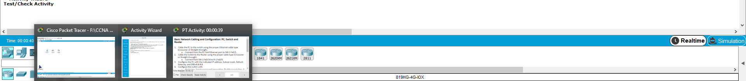

Unlocking the Packet Tracer Grading Rubric Check Activity (cont)
If the instructions portion of the Activity is not visible on your screen, locate the Packet Tracer icon(s) in the taskbar at the bottom of the screen and select the one that opens the instructions.
2
1

Slide 12
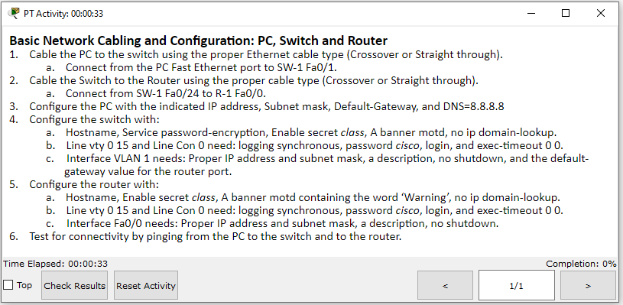
Unlocking the Packet Tracer Grading Rubric Check Results
At the bottom of the instructions screen, select the ‘Check Results’ box.

Slide 13
Unlocking the Packet Tracer Grading Rubric Assessment Items
If the Assessment Items were previously locked, they should now be available. Select ‘Assessment Items’ and the green checkmarks and red X’s should be visible. At a minimum, this will indicate what items are correct and those that the rubric considers wrong. However, it is not always clear what is expected and some of the entries can be cryptic.

Slide 14
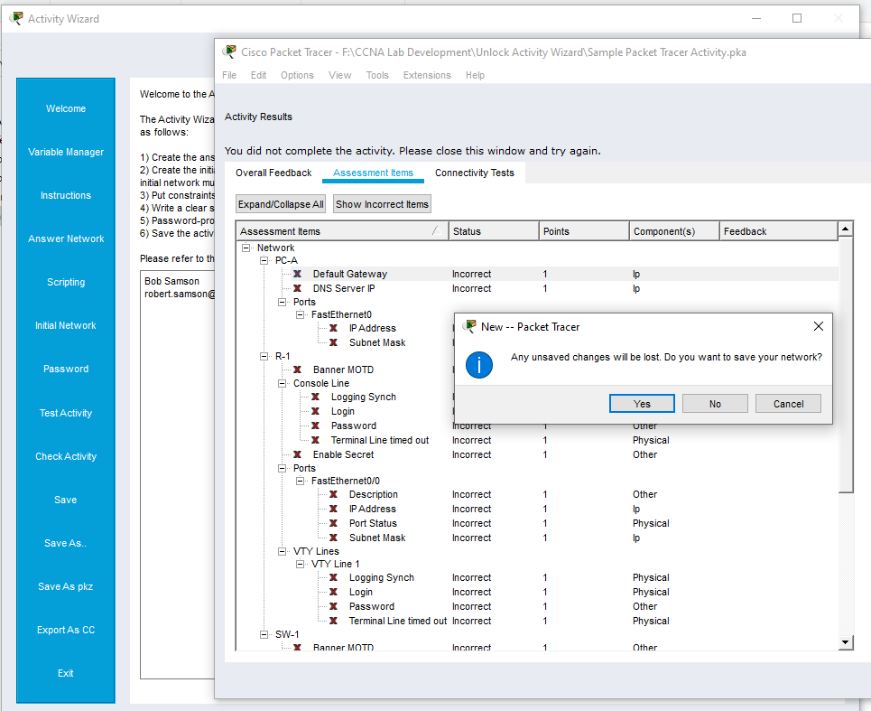
Unlocking the Packet Tracer Grading Rubric Close if Done
If this is all that was needed, close the Packet Tracer without saving it. If you save it, all configurations will be erased.
Any items that need to be corrected can be done by reloading the original file and making changes to it.
2
1

Slide 15
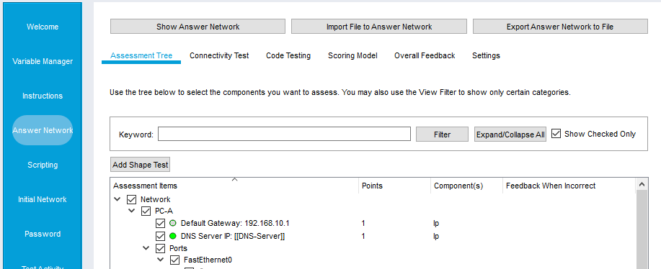
Unlocking the Packet Tracer Grading Rubric Answer Network
To see the details about the actual values being used for grading, the Activity Wizard >> Answer Network and ‘Assessment Tree’ need to be accessed.
Note the ‘Expand/Collapse All’ and ‘Show Checked Only’ boxes.
2
1

Slide 16
Unlocking the Packet Tracer Grading Rubric Variables
Some of the values that are being graded are directly displayed here (1). Others may appear surrounded by double braces ‘[[ ]]’ (2). These are variables and their values are stored in a different location within the Activity Wizard.
1
2

Slide 17
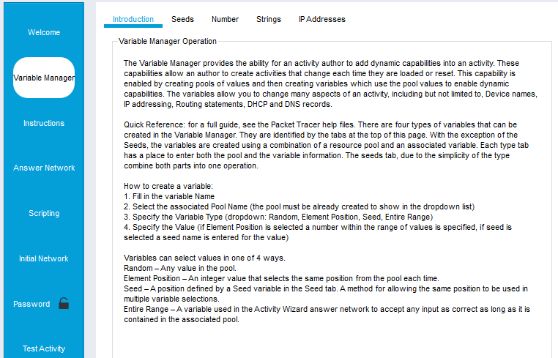
Unlocking the Packet Tracer Grading Rubric Variables (cont)
There are several types of variables, however they all allow the possibility of multiple choices to match a user’s entry. Use the ‘Variable Manager’ tab in the left column to access the values in the variables section.

Slide 18
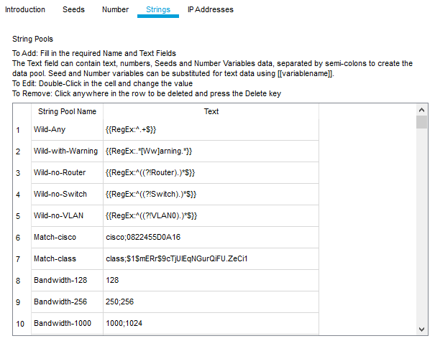
Unlocking the Packet Tracer Grading Rubric Variables (cont)
Here are some examples of values used in ‘String Variables’:

Slide 19
Unlocking the Packet Tracer Grading Rubric Variables (cont)
Some variables use ‘Regular Expressions’ to allow matches for several different values:
Wild-Any: {{RegEx:^.+$}} This will match any non-blank entry.
Wild-With-Warning: {{RegEx:.*[Ww]arning.*}} Matches an entry with ‘Warning’ or ‘warning’ anywhere in the text.
Wild-no-Router: {{RegEx:^((?!Router).)*$}} Match any entry that does not begin with ‘Router’. Good for determining if the router hostname has been configured.
Wild-no-VLAN: {{RegEx:^((?!VLAN0).)*$}} Match any VLAN name that does not begin with ‘VLAN0’. Good for determining if a VLAN name has been changed from its default.

Slide 20
Unlocking the Packet Tracer Grading Rubric Variables (cont)
Some variables use one or more entries separated by semi-colons. Some examples:
Match-cisco: cisco;0822455D0A16 This will match ‘cisco’ or the encrypted version of ‘cisco’.
Match-class: class;$1$mERr$9cTjUIEqNGurQiFU.ZeCi1 This will match class or the MD-5 hashed value from ‘enable secret’.
Bandwidth-1000: 1000;1024 This will match entries of either 1000 or 1024. Good for a link that is designated as 1 Mbps.
Note: Creating Variables and Regular Expressions is beyond the scope of this presentation.

Slide 21
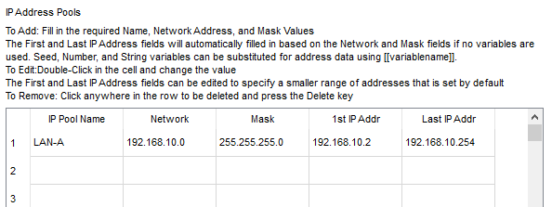
Unlocking the Packet Tracer Grading Rubric Variables (cont)
Variables can also be used to define ranges of IP addresses to allow DHCP assignments or user latitude when choosing which address to use.
Variable LAN-A will match any value between 192.168.10.2 and 192.168.10.254.

Slide 22
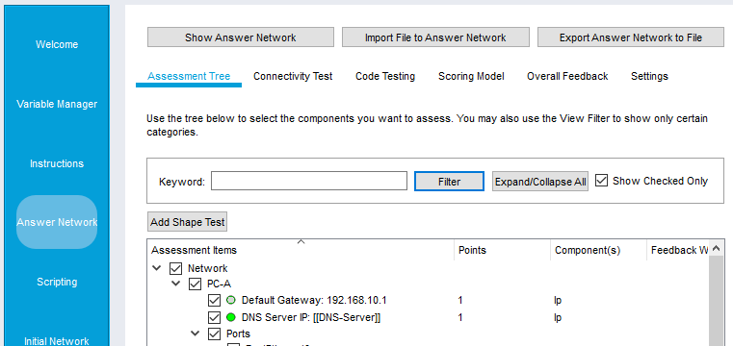
Unlocking the Packet Tracer Grading Rubric Answer Network
You may also access the ‘Answer Network’ to see the running configurations of the devices. Choose the ‘Answer Network’ tab from the left column and then select ‘Show Answer Network’ from the top row tabs.
2
1

Slide 23
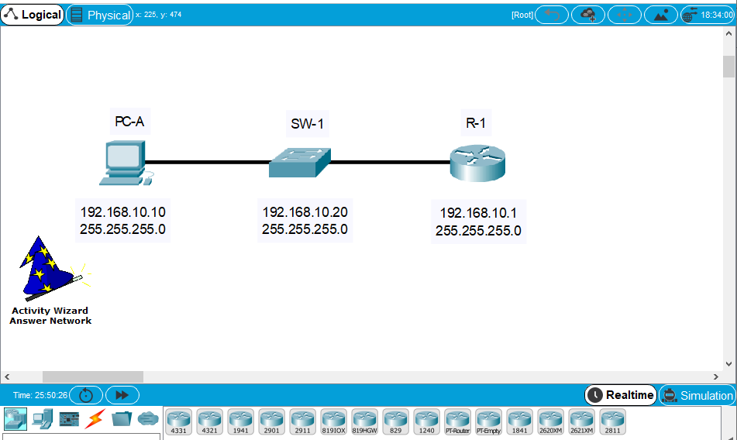
Unlocking the Packet Tracer Grading Rubric Answer Network (cont)
Notice the Activity Wizard hat in the diagram reminding you what screen you are accessing.
You may now open any of the devices and see their configurations.

Slide 24
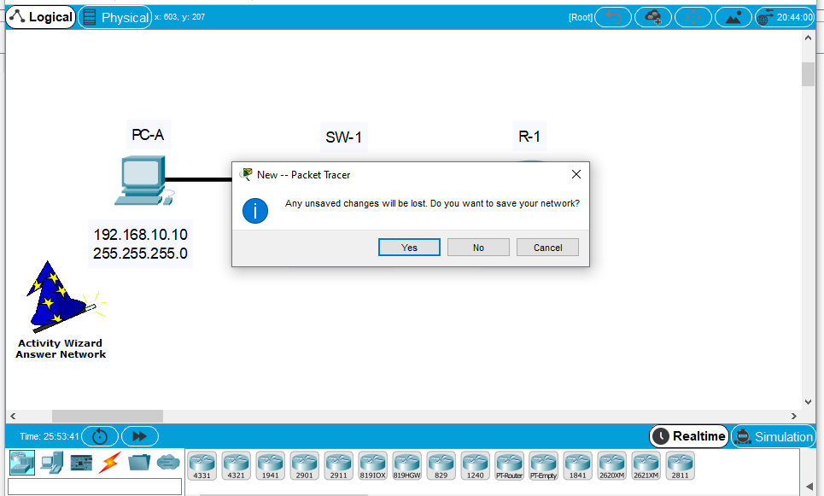
Unlocking the Packet Tracer Grading Rubric Exit When Done
A final reminder to make notes about the errors and exit without saving. Reload the saved file and make corrections there. ‘Yes’ is the default value, so you will have to select the ‘No’ box manually.

